Slide 1
A Formal Performance Tuning Methodology:
Wait-Based Tuning
Steven Haines
Quest Software

Slide 2
Agenda
State of the Market
Performance Testing Process
Performance Tuning Process
Load Testing Methodology
Wait-Based Tuning
  Identifying Wait-Points
  Tune Backwards

Slide 3
State of the Market
Forrester reported that among companies with revenue of more than $1 billion, nearly 85% reported experiencing incidents of significant application performance degradation. Respondents identified the application architecture and deployment as being of primary importance to the root cause of application performance problems.
Notes:
Industry analysts and my personal observations agree: enterprise applications are failing to meet expected performance criteria when they are deployed to a production environment. Performance tuning and performance testing can be daunting tasks because of the complexity of enterprise systems and the very nature of Java EE. Consider that your application runs in an application server that runs in a JVM that runs on an operating system that runs on hardware; this is referred to as the layered execution model. And rarely do we deploy an application to a single application server, but rather divide our application into logical and physical tiers, hence distributing this layered execution model. Furthermore our applications interact with back-end data sources, legacy systems, web services, workflow engines, abstraction layers such as web frameworks and portal engines, an so on. An enterprise application has so many moving parts that tuning such an environment and identifying the root cause of a performance problem is a very difficult task.

Slide 4
The Cost of Failure
Business to Consumer
  Site abandonment = lost revenue
Business to Business
  Damaged business relationships = lost opportunity
Internal
  Loss of organizational efficiency
  Slower time-to-market
  Loss of competitive edge
Notes:
We have to take the performance and reliability of our business-critical J2EE systems seriously, as seen in our first customer case study. Whether you’re developing B2C, B2B or even internal application, the price for failure is high. Not only does it effect your reputation within the organization, it makes it difficult for the company to compete. Fickle consumers will often abandon your site due to poor performance, many never will return. Or perhaps it might damage a critical business relationship – can you really afford to have your communication between yourself and your suppliers or business customers failing due to unreliable systems? Many people consider internal applications to be relatively unimportant, but if the people in your company are spending time complaining about the systems they interact with day-to-day, they’re not working to their potential, and your business will suffer.

Slide 5





Java EE Layered Execution Model
Notes:
In its simplest form, a J2EE application operates in a layered execution model.
J2EE App -> App Server -> JVM -> OS -> Hardware
Each of these layers effects the others – keeping all of them healthy and fast is a delicate balancing act
(Vertical Complexity)

Slide 6
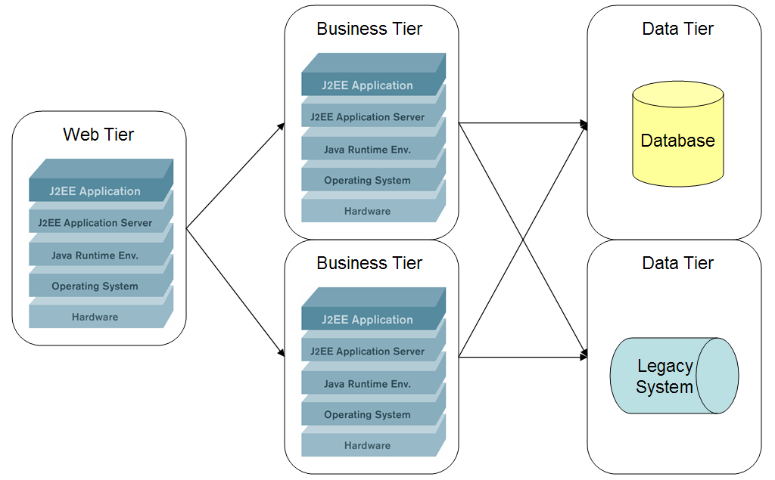
Distributed Java EE Layered Execution Model
Notes:
You need tools that can tag and follow your key transactions through your complex system to accurately relay where bottlenecks are taking place, removing the guess work from your performance tuning/troubleshooting process.

Slide 7
Complexity is on the rise
Clients
Presentation
Process
Logic
Data
Mini-Apps
Workflow / Bus
WSRP
Database
Browser
Portal
WSRP
Services
App Client
WSRP
Identity / Policy
WSRP
Portlets
Logic
Mainframes
Mobile
Web App
Workflow / Bus
WSRP
WSRP
Services
Legacy
Internal
External
WSRP
WSRP
WSRP
WSRP
Portlets
Services
This IT Objective…
Has This Impact…
Creating These IT Challenges
Build a real-time, adaptive infrastructure
Application environments are moving along an architectural continuum:
Client-Server → 3-Tier → SOA
Integrating existing apps
Changes in existing apps
Performance issues
Application consolidation
New application deployment
Notes:
The days of Web applications being implemented by a simple Servlet architecture are long gone. Consider that today our applications are accessed by different clients (browser, thick client, mobile devices) which are directed through abstraction layers such as portals and prebuilt architectures. Complex business processes are implemented by workflow engines that may access local and remote web services and other external dependencies such as databases and legacy systems.
The complexity of such environments is problematic to develop and manage, let alone satisfy performance requirements. Only by adopting a structured and formalized tuning methodology can we take control of performance.

Slide 8
Performance Testing Process
The most effective way to ensure the performance of your application is to adopt a Performance Testing Methodology that spans the entire development lifecycle
Notes:
It has been stated that an ounce of prevention is worth a pound a cure, and it is certainly true in application performance tuning. Allocating development cycles to introduce performance criteria into architecture artifacts and to execute performance unit tests during development will greatly improve the probability that your application will meet its performance criteria when it is finally deployed to a production environment. From a development perspective you want to ensure that you are writing functional unit tests and then passing those functional unit tests through three profiling tasks:
1. Code Profiling: are there slow-points in your components? If so then they will only worsen when your components are integrated into an application.
2. Memory Profiling: is your component leaving lingering references to objects in the heap or is cycling objects (rapidly creating and destroying objects)? Lingering references can lead to memory leaks and object cycling can lead to undue stress for your garbage collector.
3. Coverage Profiling: are your unit tests testing a representative percentage of your code? If your code performs sufficiently and you do not detect any memory issues, but you are only testing 20% of your code then you have very little confidence in your conclusions.
If possible, you should start with solid components before commencing with tuning activities.

Slide 9
Performance Tuning Process
Load test
Tune container
Identify application bottlenecks
Iterate
Notes:
We generate balanced and representative load against our test environment, then tune the application server (container) to allow application bottlenecks to appear. After identifying low-hanging fruit, or egregiously slow code has been identified without container tuning, it is important to tune the container appropriately before concluding that the code is solid because a poorly tuned application server may mask application problems. Instead we first tune the application server and then identify true application bottlenecks.

Slide 10
Load Testing Methodology
Your preproduction tuning efforts are only valuable if the load represents real end-user behavior
  Referred to as balanced and representative service requests
Different process for new and existing applications
Notes:
It is important to use balanced and representative service requests when load testing your environment because your tuning efforts are truly only valid if your load tests represent what your users are going to do. For example, if you are tuning an intranet application for users that log in in the morning, generate reports all day, and log out before they go home, then your load tests need the appropriate balance between logon, report requests, and logoff. If your load tests logon, generate one report, and then log off, then your load tests will differ greatly from what your users are doing and hence you may tune your logon resources and inadvertently miss the seriousness of your report generation code. When your users receive your application, it may not perform as you expect it to!

Slide 11
Load Testing an Existing Application
Learn what your users are doing
  Access Logs
  End User Experience Monitor
Construct load tests to reproduce the top 80% of user actions

Slide 12
Load Testing a New Application
Estimate
  Well-defined use cases are essential
  Establish balance between application technical and business owners
Validate
  Validate usage patterns against expectations
Reflect
  Post-mortem analysis of estimations
  Learn more about your users

Slide 13
Load Testing Process
Ideally mirror production
  Problem = $$
Scale down strategies
  Scale down number of machines, but same class
  Scale down the class of machines
  Scale down both the number and class of machines

Slide 14
Wait-Based Tuning
Tuning against performance ratios and percentages can be a laborious and unfruitful task
  Difficult to assign priority to tuning parameters
  Are you really helping your users?
Instead ask, where are my requests waiting?
Notes:
The purpose of wait-based tuning is to identify the key tuning criteria for your application, as it services requests. You therefore assign a higher priority to tuning parameters that are directly in the line of satisfying user requests.

Slide 15
Wait-Based Tuning Evolution
Oracle 9 database tuning theory
  Where are queries waiting?
IBM WebSphere queue-based tuning theory
  Four areas
    Web Server
    Web Container
    EJB Container
    Database connection pools

Slide 16
Wait-Points
A wait-point represents any place in your application that a request can wait
Notes:
A wait-point is any place in your application where a request can wait. For example, a request can wait inside a queue for a thread to process it or for a database connection to be returned to a pool before executing a query.

Slide 17
Wait-Point Architectural Analysis
Wait-points need to be identified in the context of your application architecture
Notes:
There are some wait-points that affect every application, such as thread pools, but the key to efficiently performing wait-based tuning is to analyze the architecture of your application and identify its specific wait-points. For example, if you application utilizes a cache then requests can potentially wait while the cache is managed and hence the size of the cache and the hit and miss ratios are important to observe.

Slide 18
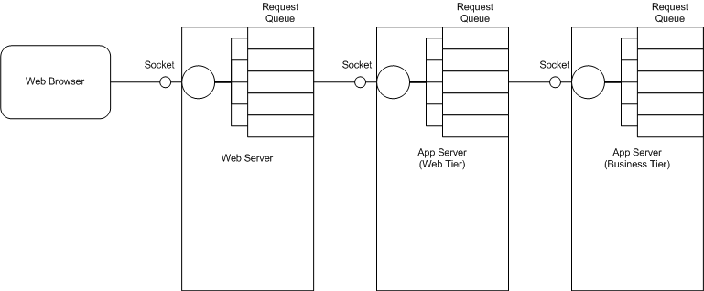
Tier Wait-Points

Slide 19
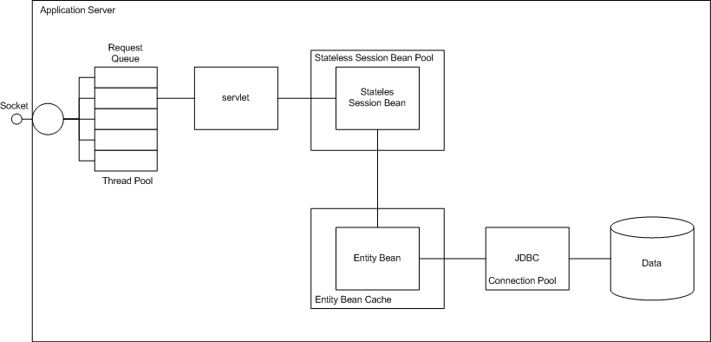
Technology Wait-Points

Slide 20
Common Wait-Points
Web server thread pools
Application server or tier thread pools
Stateless Session Bean and component pools
Caching infrastructure
Persistent storage or external dependency pools
Messaging infrastructure
Garbage collection
Notes:
As applications are divided into tiers, each tier has a request queue and an associated thread pool that satisfies requests in that queue: if a thread is not available to service that request then the request waits for a thread to be returned to the pool.
Applications that interact with back-end resources, such as databases and legacy systems, through a pool of connections will wait for a connection if the pool is empty. It is important to tune pool sizes to direct the appropriate amount of traffic to the back-end resource and ensure that requests do not back up waiting for connections.
As with connections, components that are pooled run the same risk that a request might wait while all components are in use.
Caching is an incredible technology that the JBoss’s Marc Fleury rightfully claimed in his blue paper (Why I Love EJBs) can increase the performance of an application by an order of magnitude: the reason being that satisfying an object request from memory is much faster than accessing a database across a network to obtain the object. The danger in caching, however, is that the cache must be sized appropriately or the cache will thrash. If a great percentage of object requests are not being satisfied by the cache then the cache overhead may become a bottleneck: rather than just retrieving the object from the database the request is forced to search the cache for the requested item, choose an object to removed from the cache (for example by using a least recently used (LRU) algorithm), potentially persist that object, retrieve the requested object from the database, put the requested object into the cache, and finally return the requested object back to the caller. This overhead can negate the value that the cache provides.
Because your application runs inside a JVM, garbage collection can greatly affect its performance. Whenever a major garbage collection occurs, the JVM suspends all execution threads while it reclaims memory. The reason for this is that it must construct a set of all directly visible objects for all active threads (called the root set) and subsequently perform a reachability test from that root set to all live objects in the heap. This is called the "mark" phase in garbage collection because the JVM "marks" all live objects in the heap. The next phase, the "sweep" phase, reclaims all unreachable objects. Finally, the garbage collector may perform a "compaction", or defragmentation, of the heap. While this occurs all threads are suspended, meaning that ALL requests are waiting.

Slide 21
Tune Backwards
It is better to queue requests in a business logic-lite tier to minimize the impact on the business tier
  If a request has a Web server thread and it is not ready for processing, why obtain an application server thread and database connection?
  Instead, the request should wait at the Web server
Notes:
The notion of tuning backwards exists to help you find the saturation points of your limiting resources and then only send enough load to those resources to ensure they perform optimally without actually saturating them. It is far better for a database to run at 85% CPU with a high throughput and cause a request to backup in the Web tier rather than to allow the request to get to the database, hence forcing the database CPU to 100% and throughput to drop. When resources saturate then the resource spends more time context switching between requests and hence application throughput drops. And worse still, this causes response time to increase exponentially!

Slide 22
Process
Open all wait-points and load test until a wait-point resource saturates
Scale down the limiting wait-point until it no longer saturates
  This identifies the capacity of the wait-point’s resource
Tune other wait-points to only feed enough load to the limiting wait-points

Slide 23
For Example
If an application server instance can only service 50 simultaneous database requests, then you want to send through only enough requests to generate at most 50 database requests
Any additional requests will simply queue up at the database

Slide 24
Bringing It All Together
Analyze architecture and identify wait-points
Open all wait-points
Generate balanced and representative load
Identify limiting wait-point’s saturation point
Tighten wait-points to facilitate only the maximum load of the limiting wait-point
Force pending requests to the Web server
If load is too high, setup cutoff point and redirect to a “Try again later” page

Slide 25
Summary
Applications are not meeting their performance criteria in production
The solution is to
  Implement performance testing across the development lifecycle
  Tune your container according to the Wait-Based Tuning Methodology
Wait-Based Tuning
  Design proper load tests
  Identify wait-points
  Tune backwards

